Slide 1
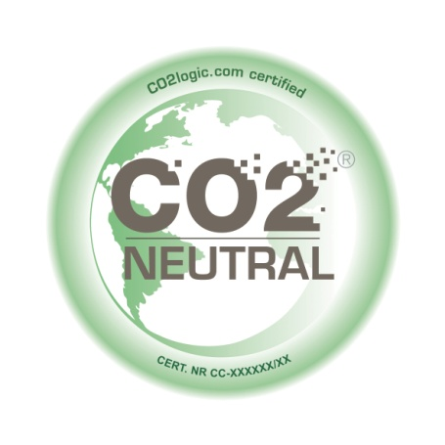
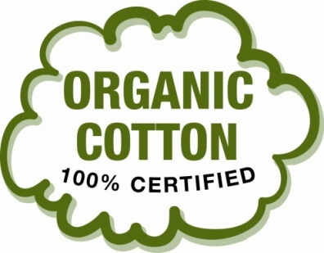
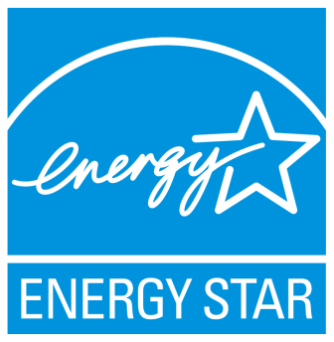
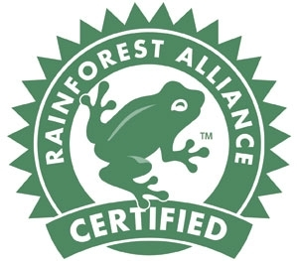
Eco & Social Responsibility Labels
Rami E. Kremesti M.Sc.

Slide 2
Low Impact Dyes/Organic Cotton
An estimated 17-20% of industrial water pollution comes from textile dyeing
Mordants fix the dye to the fabric and some are toxic
Natural vs. Synthetic Dyes?
Sustainable fabrics vs. Petrochemical fabrics

Slide 3
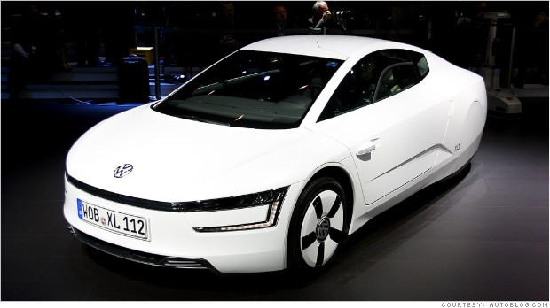
Fuel Efficient Cars with Low Emissions
"LEAF" as a acronym for Leading, Environmentally friendly, Affordable, Family car
Volkswagen XL1 does 300 MILES to the gallon
Daimler AG's marketing name for engines equipped with advanced NOx reducing technology for vehicle emissions control in diesel-powered vehicles. NOx and SOx are responsible for acid rain.

Slide 4
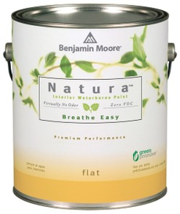
Environmentally Friendly Detergents/ Cleaners/Paint/Jeans/Paper – Green Chemistry
Archroma Advanced Denim – Eco Jeans
Environmentally Friendly Paint
High BOD₅ low COD

Slide 5
Eco Friendly Cosmetics
British Union for the Abolition of Vivisection (BUAV)

Slide 6
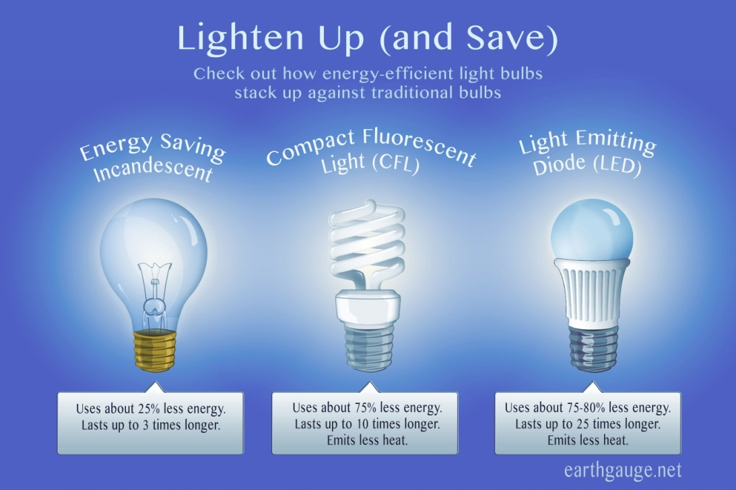
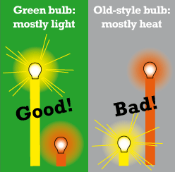
Halogen Free Electrical Cables/Eco Light Bulbs
Restriction of the Use of Certain Hazardous Substances ( RoHS )
Low Smoke Halogen Free (LSHF)

Slide 7
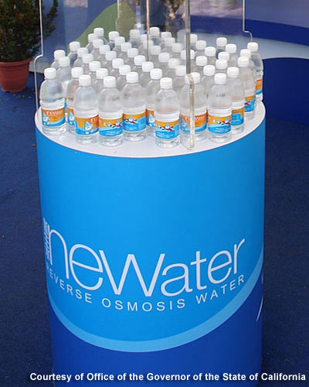
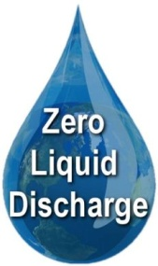
Waste Water Treatment and Water Recycling
NEWater is treated sewage that is fit for drinking !
Notes:
NEWater is the brand name given to reclaimed water produced by Singapore's Public Utilities Board. More specifically, it is treated wastewater (sewage) that has been purified using dual-membrane (via microfiltration and reverse osmosis) and ultraviolet technologies, in addition to conventional water treatment processes. The water is potable and is consumed by humans, but is mostly used by industries requiring high purity water.

Slide 8
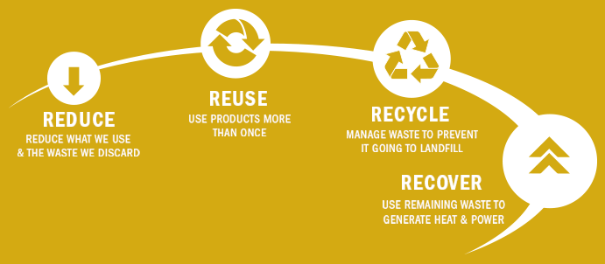
Recycling: The 4 R’s
Paper – cardboard – plastic – organic waste – glass - cooking oil – used light bulbs – batteries – cans – electronics

Slide 9
Environmental Impact Assessment

Slide 10
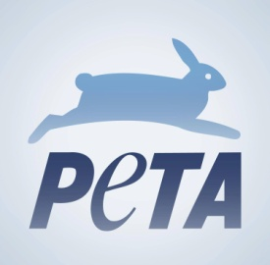
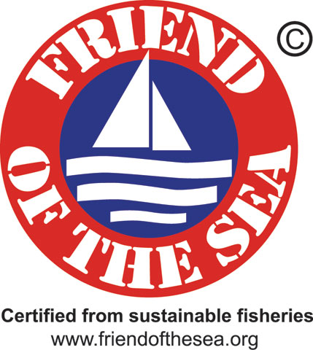
Low Impact Organic Farming/Food
No harmful pesticides
No harmful herbicides

Slide 11
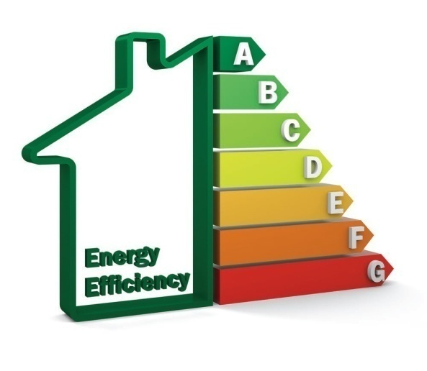
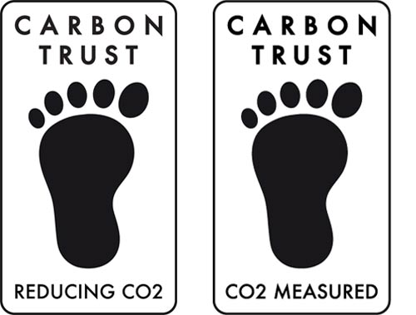
Low Carbon Footprint Homes/Appliances/Offices
Passive House homes can use as low as 2000 W of power for heating or cooling a home
MINERGIE is a registered Swiss quality label for new and refurbished low-energy-consumption buildings.

Slide 12
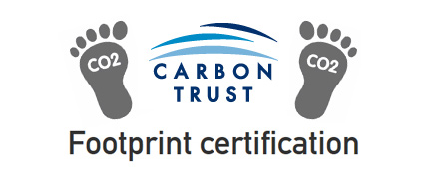
Eco-Friendly/Socially Responsible Mobile Phones
“We're putting social values first and opening up the supply chain. One step at a time.”

Slide 13
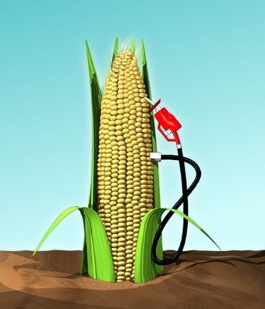
Bio fuels/Biomass/Renewable Power

Slide 14
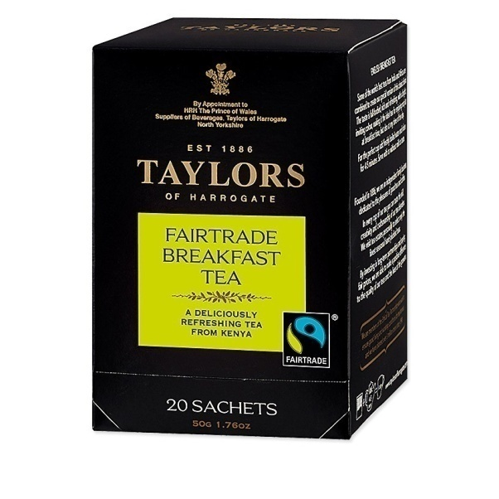
Fairtrade

Slide 15
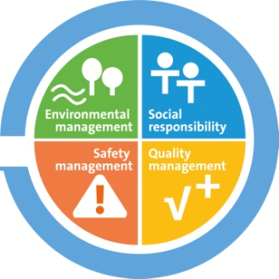
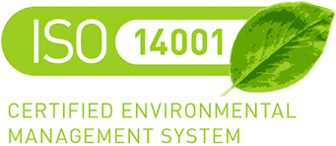
Standards
ISO 26000 - Social responsibility
UK WEEE Directive (Waste Electrical and Electronic Equipment )
http://ec.europa.eu/environment/ecolabel/
ISO 14046 & 14067 – Water/ Carbon Footprint
ISO 50001 Energy management systems

Slide 16
Finally
“Are you polluting the world or cleaning up the mess? You are responsible for your inner space; nobody else is, just as you are responsible for the planet. As within, so without: If humans clear inner pollution, then they will also cease to create outer pollution.”
Eckhart Tolle

Slide 17
Contact Info
rami@kremesti.com <- Email
http://kremesti.com/ <- Web

